Slide 1
Year 10 Parent Talk
October 2020

Slide 2

Es el último año de Secundaria en México, penúltimo en el Reino Unido
Es el inicio de su curso IGCSE que conforma 2 años de trabajo
Los exámenes de Yr 11 este año tendrán un costo aprox de $ 20,000.00

Slide 3
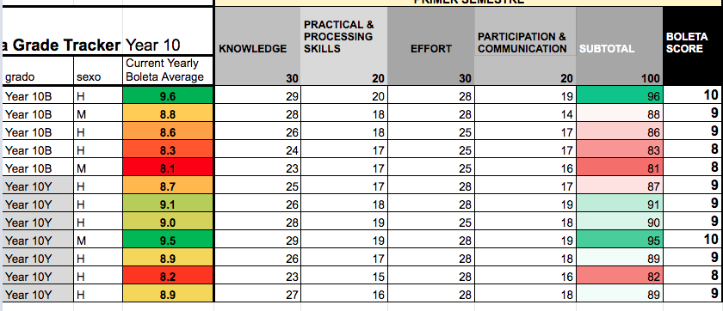
Boletas
Year 10 three times a year
The last of these criteria changes slightly throughout the year.
Respect for others, Punctuality etc.

Slide 4
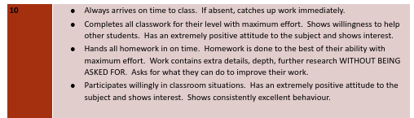

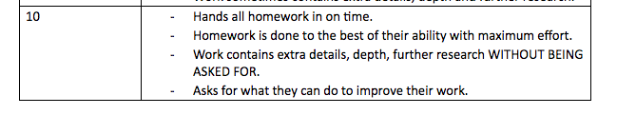
BOLETAS: Grading
How can I avoid low effort grades?
Try to produce work that you consider to be high quality, always push yourself to improve.
Show interest and enthusiasm, ask questions
Try to contribute to the “learning environment” of your whole group.
Plan your time sensibly at home (using your diary)
Avoid copying from other students or directly from source material
Try not to be absent.
Arrive to class on time
Talk to your tutor and/or your teacher if you feel you are having difficulties.

Slide 5
IGCSE Courses
History, Global Perspectives, Business, ICT, Mandarin, Biology, Chemistry, Physics, Environmental Management, Design, Art, PE
Year 10 have 10 subjects / classes: (4 options + English Lang, English Lit, Spanish, Spanish Lit, Maths)
They will sit their final IGCSE exams at the end of year 11 in April / May of 2022.
Coursework is a part of many of the options though and this is just as important as exams - sometimes worth 50% of the course.
There will also be mock exams that are important to prepare for properly.
Important to miss as little time as possible from these exam courses in Prepa.

Slide 6

Criterios IGCSE
5 Ds or above at IGCSEs to continue into AS levels in VICTORIA.
UNAM revalidation requires 6 Pass grades (at G or above)
We really want to encourage more than this.
University applications
Future jobs
Academic careers
Really should be trying to get as high as possible; As and Cs onIGCSEs are definitely attainable!

Slide 7

Revalidación
Revalidation:
Year 10: Revalidation is based on SEP boleta grades.
Year 11: 6 G+ at IGCSE for the UNAM (SEP is only Years 7-10 then the UNAM takes over). As a school, our guideline to go comfortably into Year 12 is 5 IGCSEs at D+, but this is considered on a case by case basis. It's at this level as a guideline for the academic level the AS levels involve, but loads of other factors e.g. if they can do A level Art, if they can get their IELTS, etc.
Year 13: 4 AS Levels E+ (A levels count as 2 so usually 100% have 2 in the bag with Spanish). An IELTS pass at 6.5 counts as an AS level too.

Slide 8
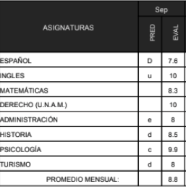
Communication about progress
Reports - Monthly
Feedback Friday
In school interventions
Parent Meetings
We are always happy to talk if you want to arrange a meeting!

Slide 9







Becas

